Slide 1


ADVANCED BUSINESS ANALYTICS DIABETIC DATA PROJECT GROUP 8 Chintala Kaashyap Shashwat Dubey Patrick Todjalla Rudra Sabitra Gupta Dakor Erika Ergart

Slide 2
AGENDA
Introduction
Objective
Exploratory Data Analysis
Survival Analysis KM
CoxPH Model
Outlier Analysis
Conclusion
Checking for Constant Hazard Ratio
Data Pre-processing

Slide 3
INTRODUCTION
Project Overview
Lasik Surgery Dataset
Survival Analysis
Recommendations for Diabetic patients based on the results
Objective
Determine if any input variable has significance with respect to the target variable
Look for any potential linearity and/or constant Hazard ratio to strengthen reliability of treatment/procedure
Deduct logical conclusions and provide "best practice" suggestions

Slide 4
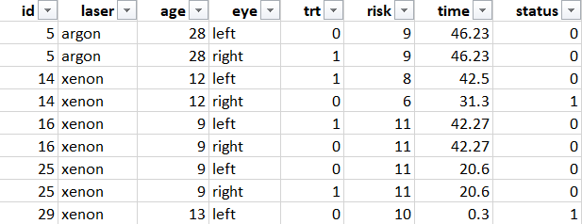
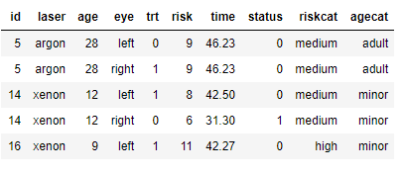
DATA PRE-PROCESSING
Laser:- Laser Type Radon or Xenon
Age:- Age at the time of diagnosis
Eye :- Left or Right Eye
Trt:- Treatment 0 = no , 1= laser treatment
Risk:- Risk Group of 6-12
Time:- Time to event or last follow up
Status:- 0= censored , 1 = visual loss
ID :- Subject ID

Slide 5
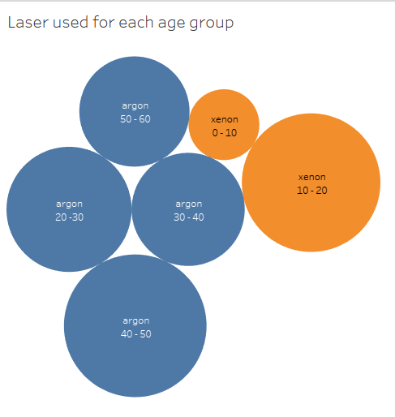
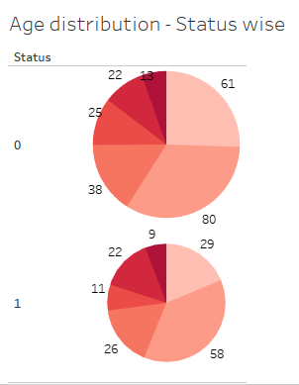
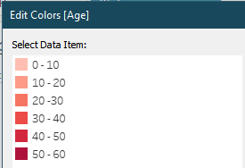
EXPLORATORY DATA ANALYSIS

Slide 6
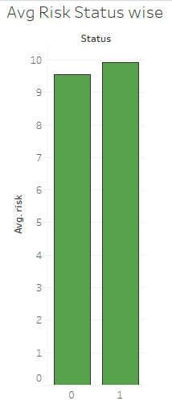
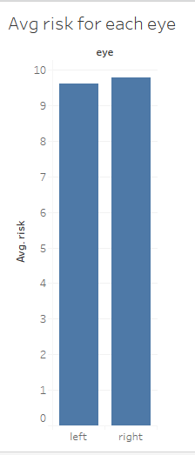
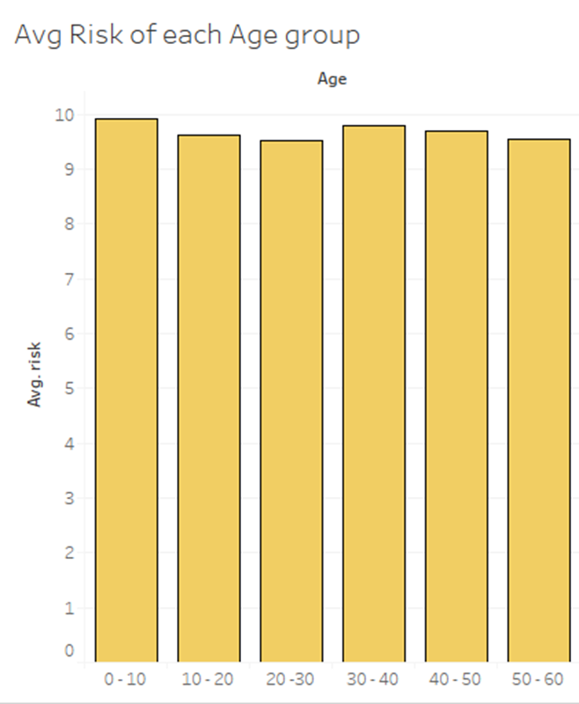
EXPLORATORY DATA ANALYSIS

Slide 7
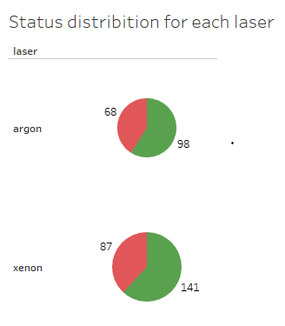
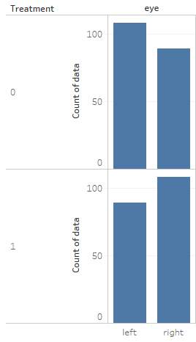
EXPLORATORY DATA ANALYSIS

Slide 8

SURVIVAL ANALYSIS KAPLAN - MEIER

Slide 9
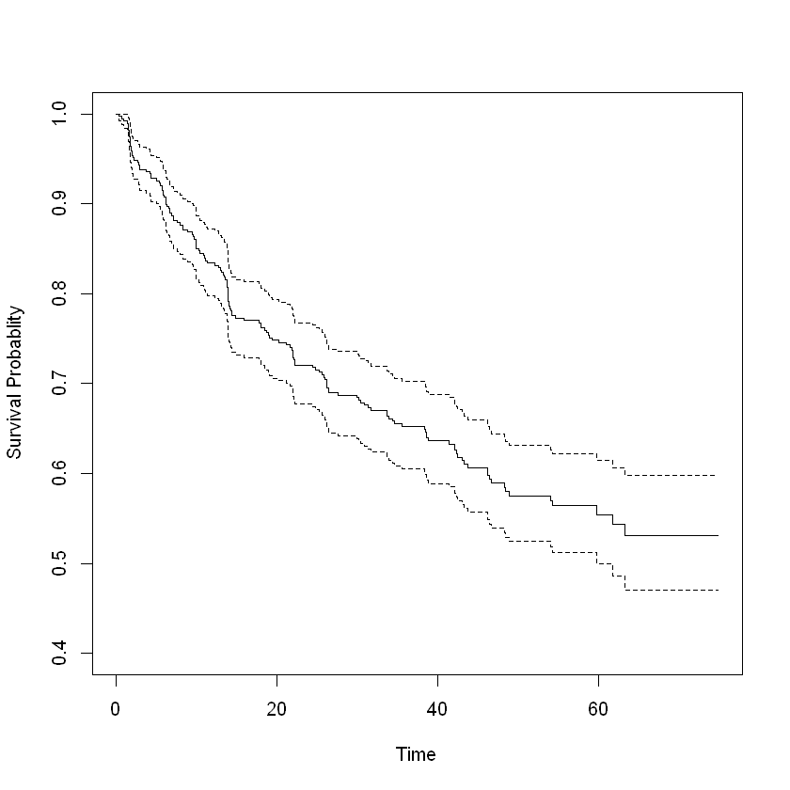
SURVIVAL PLOT

Slide 10
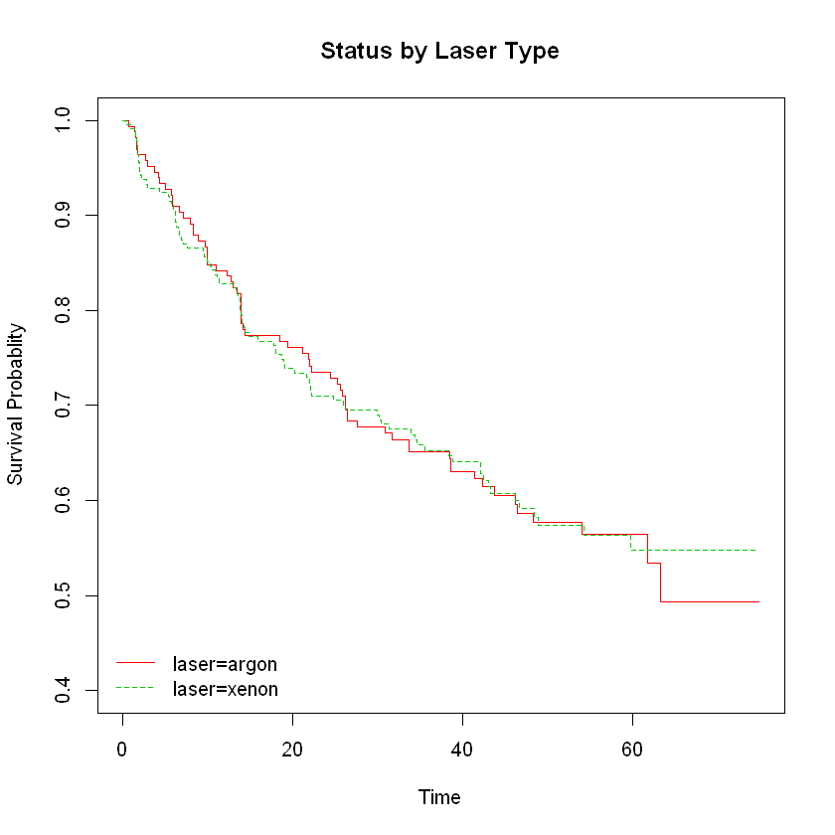
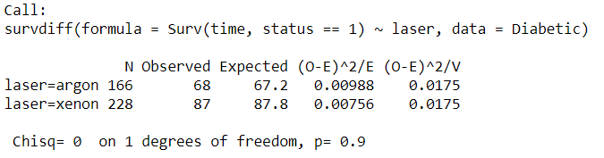
STATUS BY LASER TYPE
From the visual representation of the survival probability and from the high p-value of 0.9 of the log-rank test, it is possible to conclude that there is not much significant difference between the proportion of patients with visual loss by laser category

Slide 11
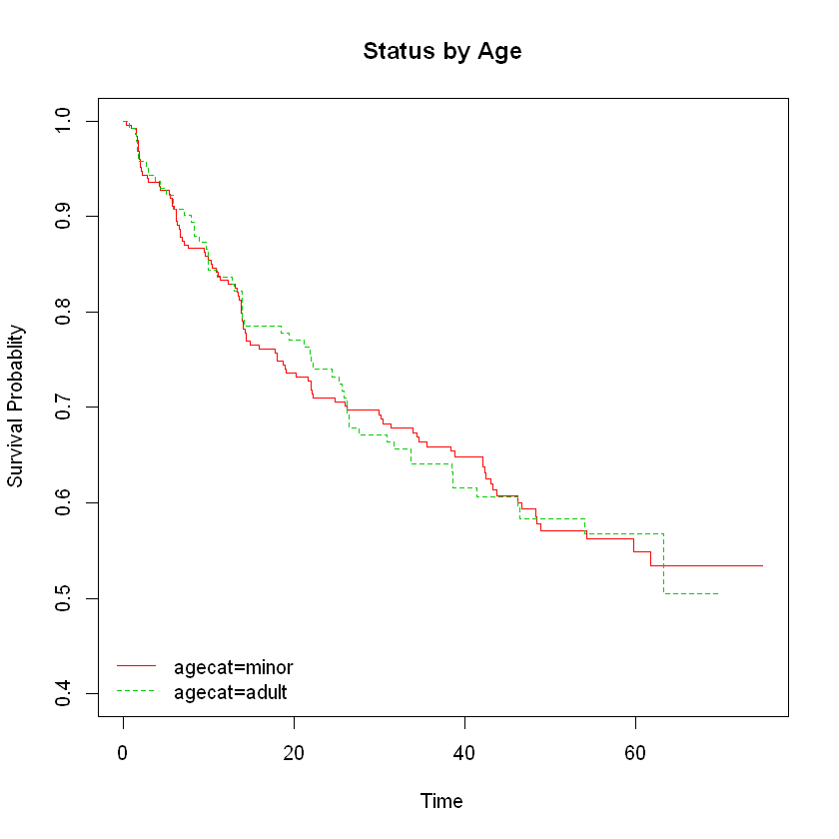
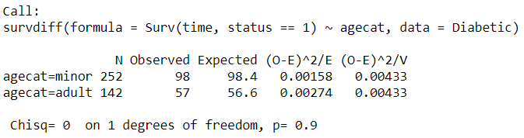
STATUS BY AGE
From the visual representation of the survival probability and from the high p-value of 0.9 of the log-rank test, it is possible to conclude that there is not much significant difference between the proportion of patients with visual loss by age category

Slide 12
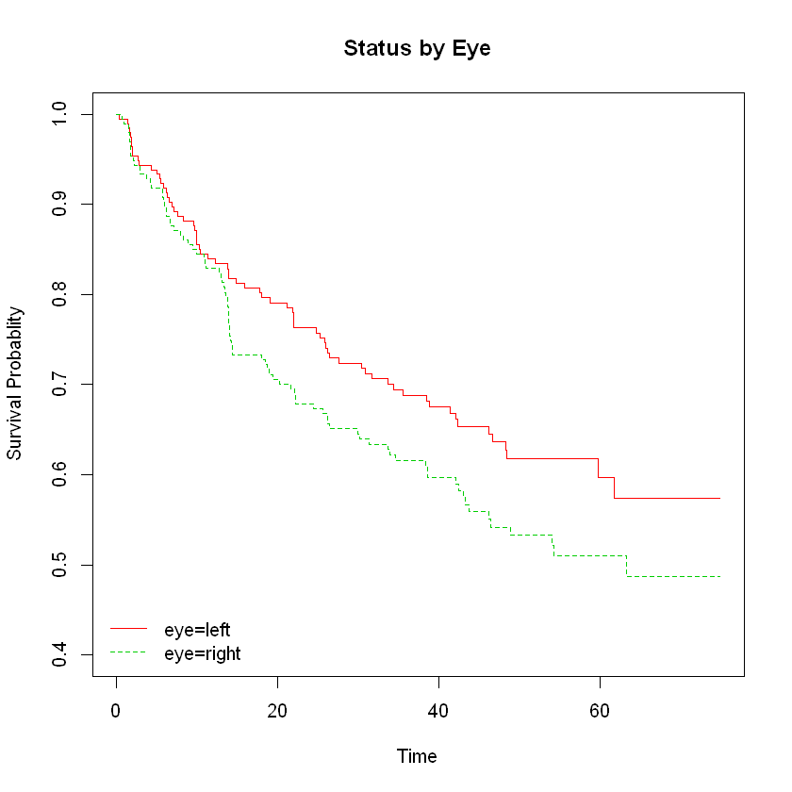
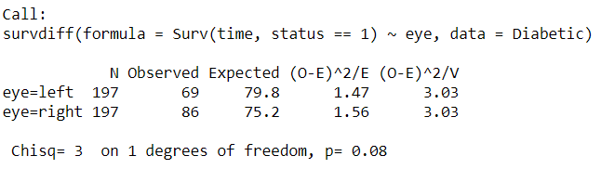
STATUS BY EYE
The high p-value of p-value from the log-rank analysis demonstrates that there is not a significant difference between the proportion of patients with visual loss by the eye factor

Slide 13
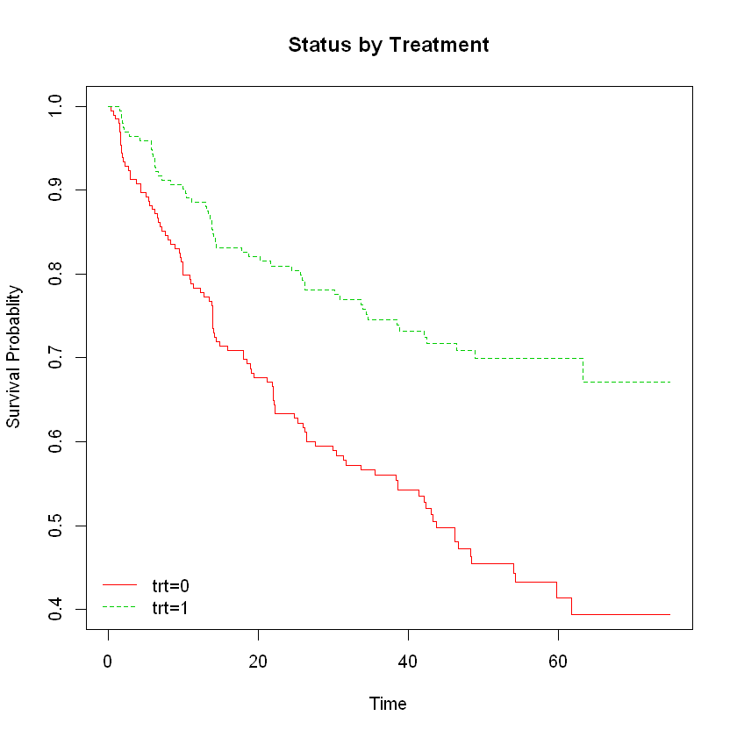
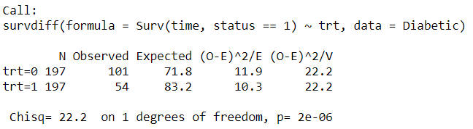
STATUS BY TREATMENT
From the visual representation of the survival probability and from a low p-value of 2e-06 of the log-rank test, it is possible to conclude that there is a significant difference between the proportion of patients with visual loss by treatment group

Slide 14
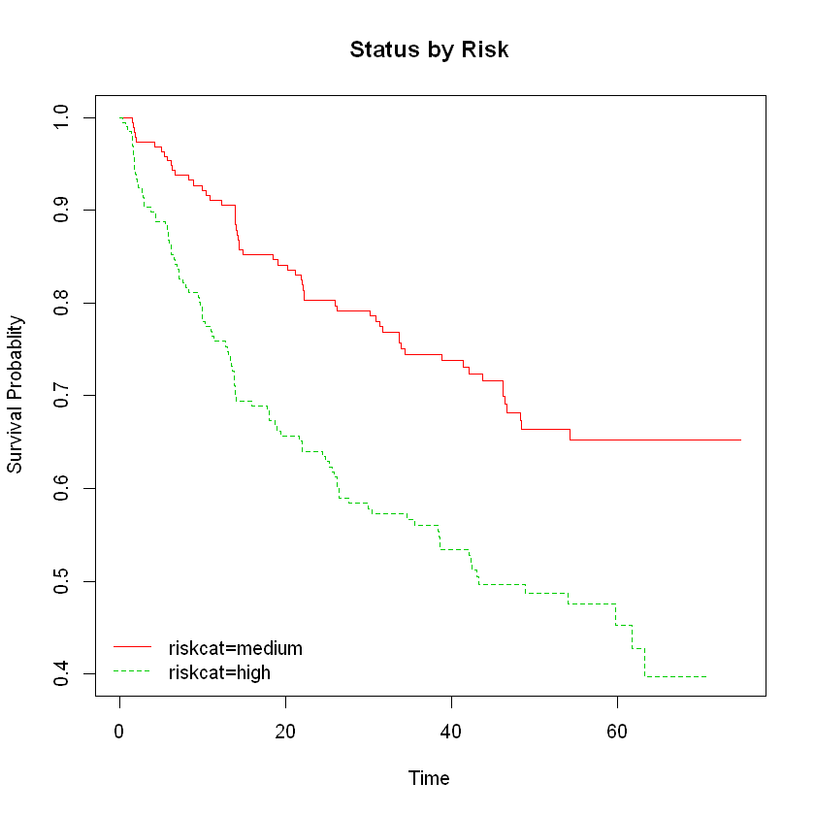
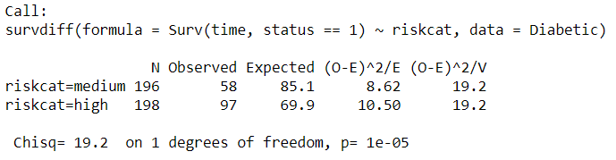
STATUS BY RISK
From the visual representation of the survival probability and from a low p-value of 0.00001 of the log-rank test, it is possible to conclude that there is a significant difference between the proportion of patients with visual loss by risk category

Slide 15
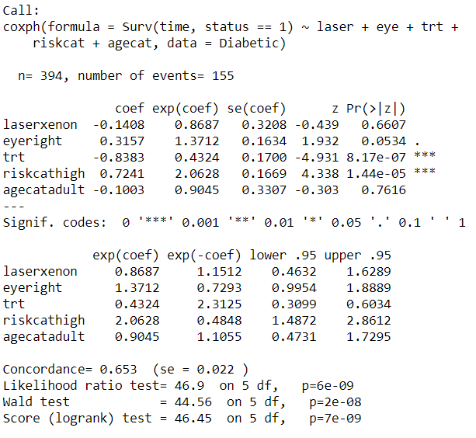
CoxPH MODEL
The overall model’s p-value of 5.946e-09 means that the model is meaningful and would accurately portray the visual loss of patients
trt1 is significant based on p-value (8.17e-07)
Interpreting exp(coef) we can conclude, compared to the reference variable trt0, trt1 is 0.57x less likely to lose vision as those who did not receive treatment
riskcathigh is significant based on p-value (1.44e-05)
Interpreting exp(coef) we can conclude, compared to the reference of riskcatmedium, riskcathigh is 1.0628x more likely to lose vision as those who are in the medium risk group

Slide 16
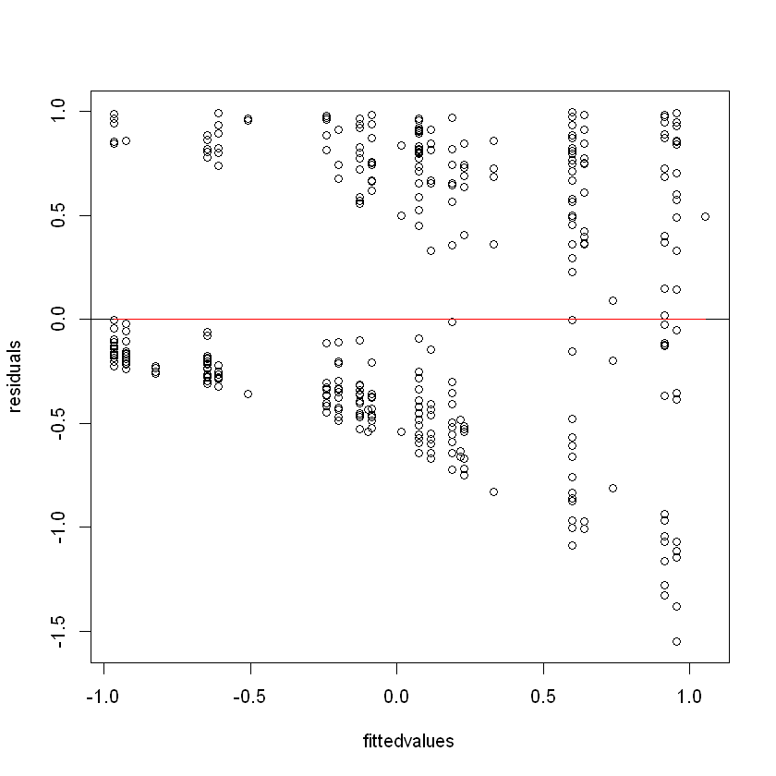
RESIDUAL PLOT
Shows clear linear residual plot

Slide 17
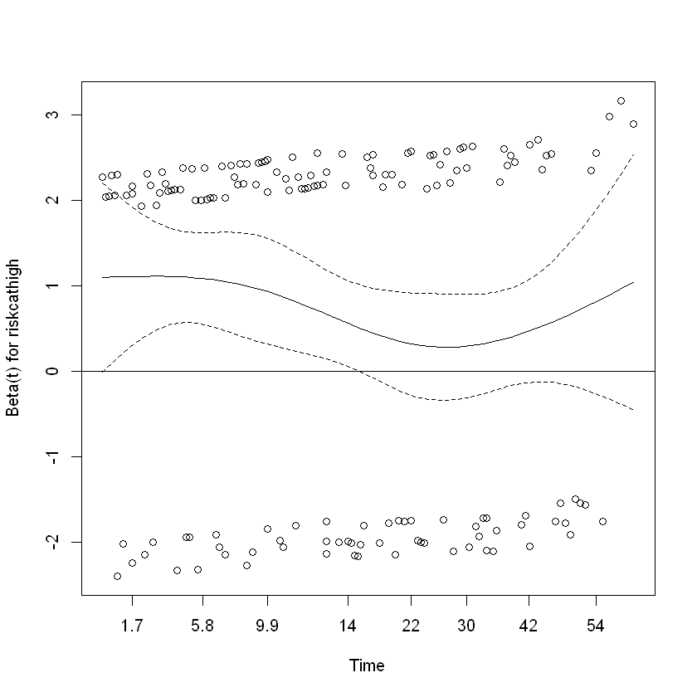
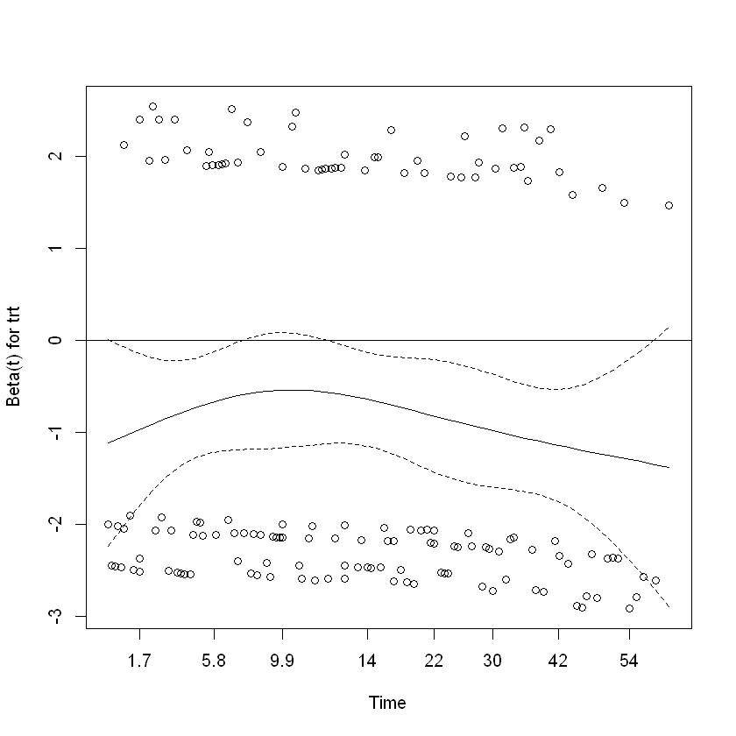
CHECKING FOR CONSTANT HAZARD RATIO

Slide 18
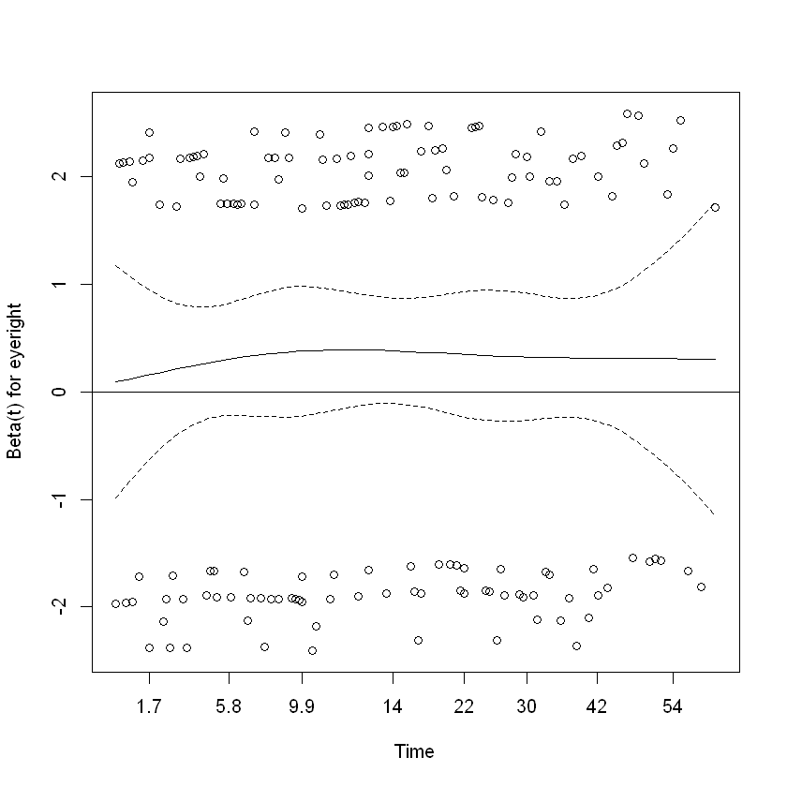
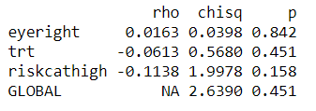
CHECKING FOR CONSTANT HAZARD RATIO
All have constant hazard ratio

Slide 19
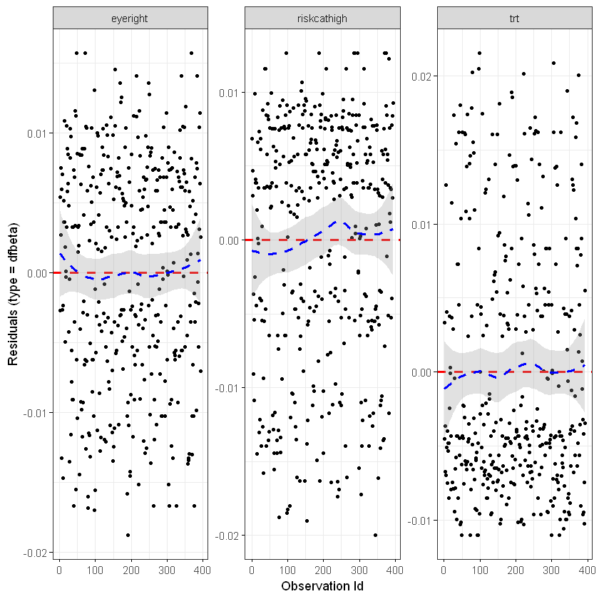
OUTLIER ANALYSIS

Slide 20
FINAL RECOMMENDATIONS
RECOMMENDATIONS
Age bracket – data incongruency
Dominant eye – more accurate results
CONCLUSION
Significance of Treatment Variable
Risk_Category group likelihood of success

Slide 21
THANK YOU

